Slide 1
Time Series: Autoregressive models ARIMA (Part2)
1 / 77

Slide 2
Revisit Auto Covariance & Auto Correlation Function(ACF)

Slide 3
Autocorrelation and ARIMA Models
When we use linear regression for time series forecasting, we are able to account for patterns such as trend and seasonality.
However, ordinary regression models do not account for dependence between values in different periods, which in cross-sectional data is assumed to be absent.
Yet, in the time series context, values in neighboring periods tend to be correlated. Such correlation, called autocorrelation, is informative and can help in improving forecasts.
If we know that a high value tends to be followed by high values (positive autocorrelation), then we can use that to adjust forecasts.
Discuss how to compute the autocorrelation of a series, and how best to utilize the information for improving forecasts.

Slide 4
Computing Autocorrelation
Correlation between values of a time series in neighboring periods is called autocorrelation, because it describes a relationship between the series and itself.
To compute autocorrelation, we compute the correlation between the series and a lagged version of the series.
A lagged series is a “copy” of the original series which is moved forward one or more time periods.
A lagged series with lag-1 is the original series moved forward one time period; a lagged series with lag-2 is the original series moved forward two time periods, etc.

Slide 5
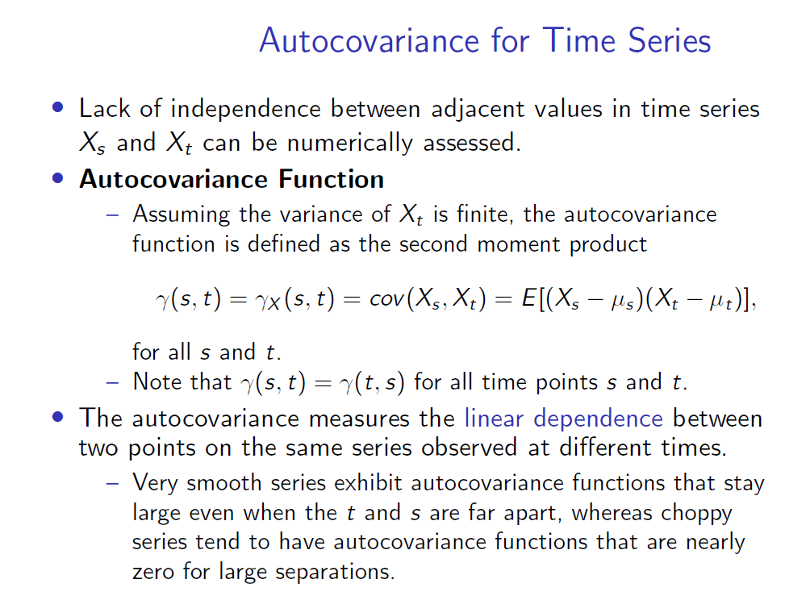

Slide 6
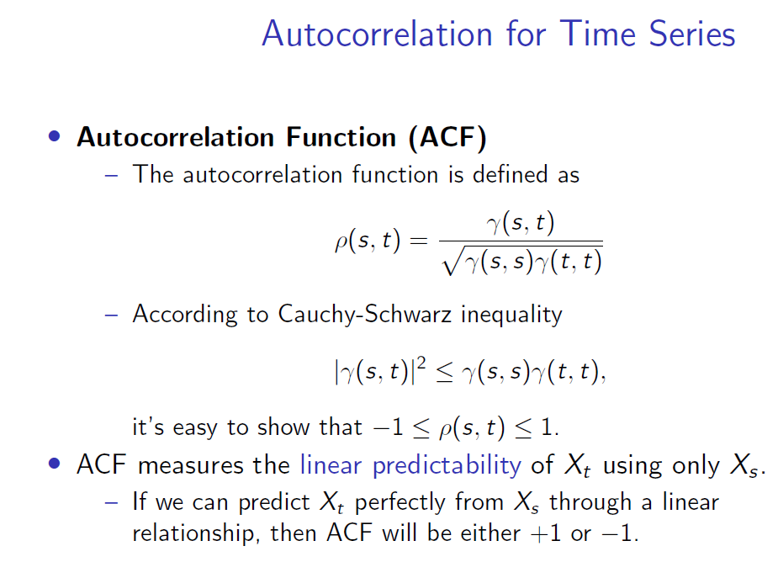

Slide 7
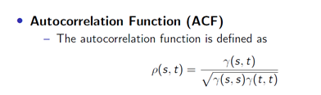

ACF

Slide 8
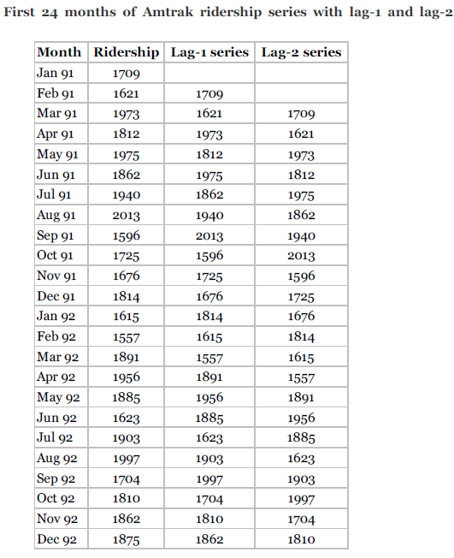
Computing Autocorrelation
Table shows the first 24 months of the Amtrak ridership series, the lag-1 series and the lag-2 series.

Slide 9
lag-1 & lag-2autocorrelation
Compute the lag-1 autocorrelation, which measures the linear relationship between values in consecutive time periods, we compute the correlation between the original series and the lag-1 series (e.g., via the function np.corrcoef) to be 0.063. (NB: lag-1 has one value less)
Similarly, the lag-2 autocorrelation, measure the relationship
between values that are two time periods apart, is the correlation between the original series and the lag-2 series (yielding −0.15).
Use statsmodel’s function
acf to compute the autocorrelation function (ACF) of a series and
plot_acf to directly create a plot.

Slide 10
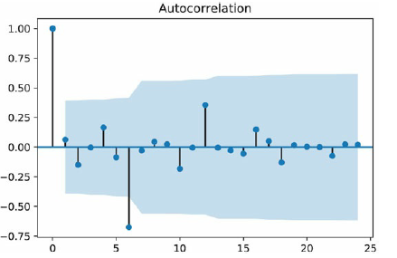
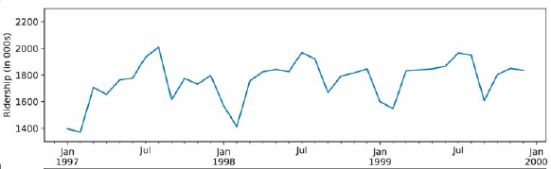
Autocorrelation of a series can therefore help to detect seasonality patterns.
The strongest autocorrelation is at lag 6 and is negative. This indicates a bi-annual pattern in ridership, with 6-month switches from high to low ridership.
A look at the time plot confirms the high-summer low-winter pattern.

Slide 11
A few typical autocorrelation behaviors
1. Strong autocorrelation (positive or negative) at a lag larger than 1 and its multiples (2k, 3k, …)
typically reflects a cyclical pattern.
For example, strong positive lag-12 autocorrelation in monthly data will reflect an annual seasonality (where values during a given month each year are positively correlated).

Slide 12
A few typical autocorrelation behaviors
1. Strong autocorrelation (positive or negative) at a lag larger than 1 and its multiples (2k, 3k, …)
typically reflects a cyclical pattern.
For example, strong positive lag-12 autocorrelation in monthly data will reflect an annual seasonality (where values during a given month each year are positively correlated).
2. Positive lag-1 autocorrelation (called “stickiness’’)
describes a series where consecutive values move generally in the same direction.
In the presence of a strong linear trend, we would expect to see a strong and positive lag-1 autocorrelation.
3. Negative lag-1 autocorrelation reflects swings in the series, where high values are immediately followed by low values and vice versa.

Slide 13
A few typical autocorrelation behaviors
Strong autocorrelation (positive or negative) at a lag larger than 1 and its multiples (2k, 3k, …)
typically reflects a cyclical pattern.
For example, strong positive lag-12 autocorrelation in monthly data will reflect an annual seasonality (where values during a given month each year are positively correlated).
Positive lag-1 autocorrelation (called “stickiness’’)
describes a series where consecutive values move generally in the same direction.
In the presence of a strong linear trend, we would expect to see a strong and positive lag-1 autocorrelation.
Negative lag-1 autocorrelation reflects swings in the series, where high values are immediately followed by low values and vice versa.

Slide 14
Auto Correlation of Residual Errors (Forecast errors)

Slide 15
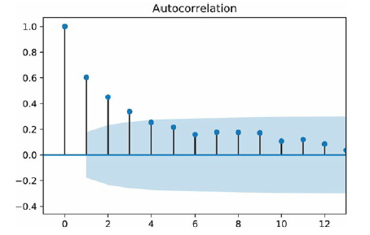
Autocorrelation of the residual series (Forecast errors)
In addition to looking at the autocorrelation of the raw series, it is very useful to look at the autocorrelation of the residual series.
For example, after fitting a regression model (or using any other forecasting method), we can examine the autocorrelation of the series of residuals.

Slide 16
Autocorrelation of the residual series (Forecast errors)
Fig displays the autocorrelations for the residuals from the regression model with seasonality and quadratic trend
It is clear that the 6-month (and 12-month) cyclical behavior no longer dominates the series of residuals, indicating that the regression model captured them adequately.

Slide 17
Autocorrelation of the residual series (Forecast errors)
However, we can also see a strong positive autocorrelation from lag 1 on, indicating a positive relationship between neighboring residuals.
This is valuable information, which can be used to improve forecasts.

Slide 18
Improving Forecasts by Integrating Autocorrelation Information

Slide 19

Improving Forecasts by Integrating Autocorrelation Information
In general, there are two approaches to taking advantage of autocorrelation.
One is by directly building the autocorrelation into the regression model, and the other is
by constructing a 2nd-level forecasting model on the residual series.
Among regression-type models that directly account for autocorrelation are autoregressive (AR) models, or the more general class of models called ARIMA (Autoregressive Integrated Moving Average) models.
AR models are similar to linear regression models, except that the predictors are the past values of the series.
For example, an autoregressive model of order 2, denoted AR(2), can be written as

Slide 20
Improving Forecasts by Integrating Autocorrelation Information
In general, there are two approaches to taking advantage of autocorrelation.
One is by directly building the autocorrelation into the regression model, and the other is by
constructing a 2nd-level forecasting model on the residual series.

Slide 21
Improving Forecasts by Integrating Autocorrelation Information
In general, there are two approaches to taking advantage of autocorrelation.
One is by directly building the autocorrelation into the regression model, and the other is
by constructing a 2nd-level forecasting model on the residual series.
Among regression-type models that directly account for autocorrelation are autoregressive (AR) models, or the more general class of models called ARIMA (Autoregressive Integrated Moving Average) models.
AR models are similar to linear regression models, except that the predictors are the past values of the series.
For example, an autoregressive model of order 2, denoted AR(2), can be written as

Slide 22
AR(2) Models - Improving Forecasts by Integrating Autocorrelation Information
An autoregressive model of order 2, denoted AR(2), can be written as
Estimating such models is roughly equivalent to
fitting a linear regression model with the series as the outcome variable, and
the two lagged series (at lag 1 and 2 in this example) as the predictors.

Slide 23
Discussion
However, it is better to use designated ARIMA estimation methods (e.g., those available in the statsmodel package) over ordinary linear regression estimation, to produce more accurate results.
Although moving from AR to ARIMA models creates a larger set of more flexible forecasting models, it also requires much more statistical expertise.
Even with the simpler AR models, fitting them to raw time series that contain patterns such as trends and seasonality requires the user to perform several initial data transformations and to choose the order of the model. These are not straight forward tasks.
NB: ARIMA modeling requires more experience and statistical expertise than other methods.

Slide 24
Example: One AR Model
Discuss one particular use of AR models that is straightforward to apply in the context of forecasting, which can provide a significant improvement to short-term forecasts.
This relates to the 2nd approach for utilizing autocorrelation, which requires constructing a second-level forecasting model for the residuals, as follows:
Generate a k-step-ahead forecast of the series (F_{t + k}), using any forecasting method
2. Generate a k-step-ahead forecast of the forecast error (residual) (E _{t + k}),
using an AR (or other) model
3. Improve the initial k-step-ahead forecast of the series by adjusting it according to its forecasted error:
Improved F*_{t + k} = F_{t + k} + E _{t + k}

Slide 25

Example: One AR Model
In particular, we can fit low-order AR models to series of residuals (or forecast errors) which can then be used to forecast future forecast errors.
To fit an AR model to the series of residuals,
first examine the autocorrelations of the residual series.
then choose the order of the AR model according to the lags in which autocorrelation appears.
Often, when autocorrelation exists at lag-1 and higher, it is sufficient to fit an AR(1) model of the form
where E_{t} denotes the residual (or forecast error) at time t.

Slide 26
Thank You
26 / 77

Slide 27
Pros-ARIMA
Only requires the prior data of a time series to generalize the forecast.
Performs well on short term forecasts.
Models non-stationary time series.

Slide 28
Cons-ARIMA
Difficult to predict turning points.
There is quite a bit of subjectivity involved in determining (p,d,q) order of the model.
Computationally expensive.
Poorer performance for long term forecasts.
Cannot be used for seasonal time series.

Slide 29
ARIMA
The right order of differencing is the minimum differencing required to get a near-stationary series which roams around a defined mean and the ACF plot reaches to zero fairly quick.
If the autocorrelations are positive for many number of lags (10 or more), then the series needs further differencing. On the other hand, if the lag 1 autocorrelation itself is too negative, then the series is probably over-differenced.
In the event, you can’t really decide between two orders of differencing, then go with the order that gives the least standard deviation in the differenced series.

Slide 30

How to find the order of the AR term (p)
Identify if the model needs any AR terms. You can find out the required number of AR terms by inspecting the Partial Autocorrelation (PACF) plot.
Partial autocorrelation can be imagined as the correlation between the series and its lag, after excluding the contributions from the intermediate lags.
PACF sort of conveys the pure correlation between a lag and the series. That way, you will know if that lag is needed in the AR term or not.
Partial autocorrelation of lag (k) of a series is the coefficient of that lag in the auto regression equation of Y.

Slide 31
How to choose the values of p,d and q
Test for stationarity using the augmented dickey fuller test.
If the time series is stationary try to fit the ARMA model, and if the time series is non-stationary then seek the value of d.
If the data is getting stationary then draw the autocorrelation and partial autocorrelation graph of the data.
Draw a partial autocorrelation graph(ACF) of the data. This will help us in finding the value of p because the cut-off point to the PACF is p.
Draw an autocorrelation graph(ACF) of the data. This will help us in finding the value of q because the cut-off point to the ACF is q.

